Slide 1

E-Commerce
Product Categorization
Rahul Singh Yadav

Slide 2
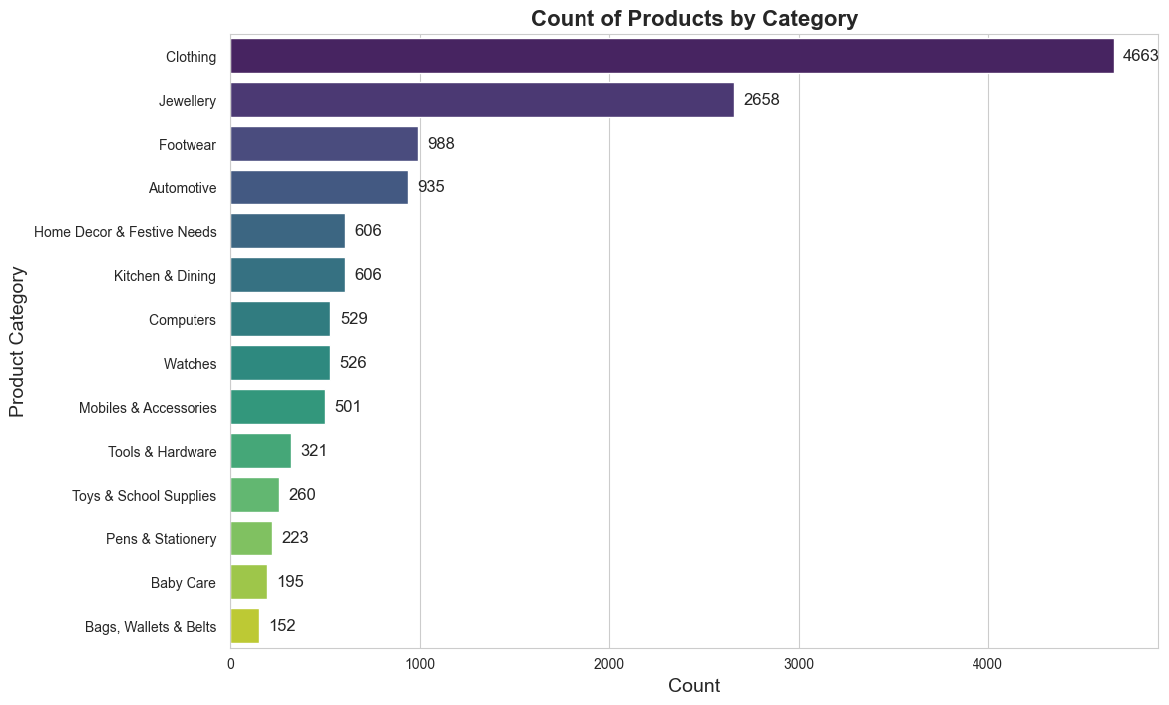
Category Distribution
Clothing and Jewelry: These categories have the highest counts, indicating that females are the primary target audience.
Baby Care and Stationery Items: These products have lower counts, suggesting that there is less focus on the kids' market.

Slide 3
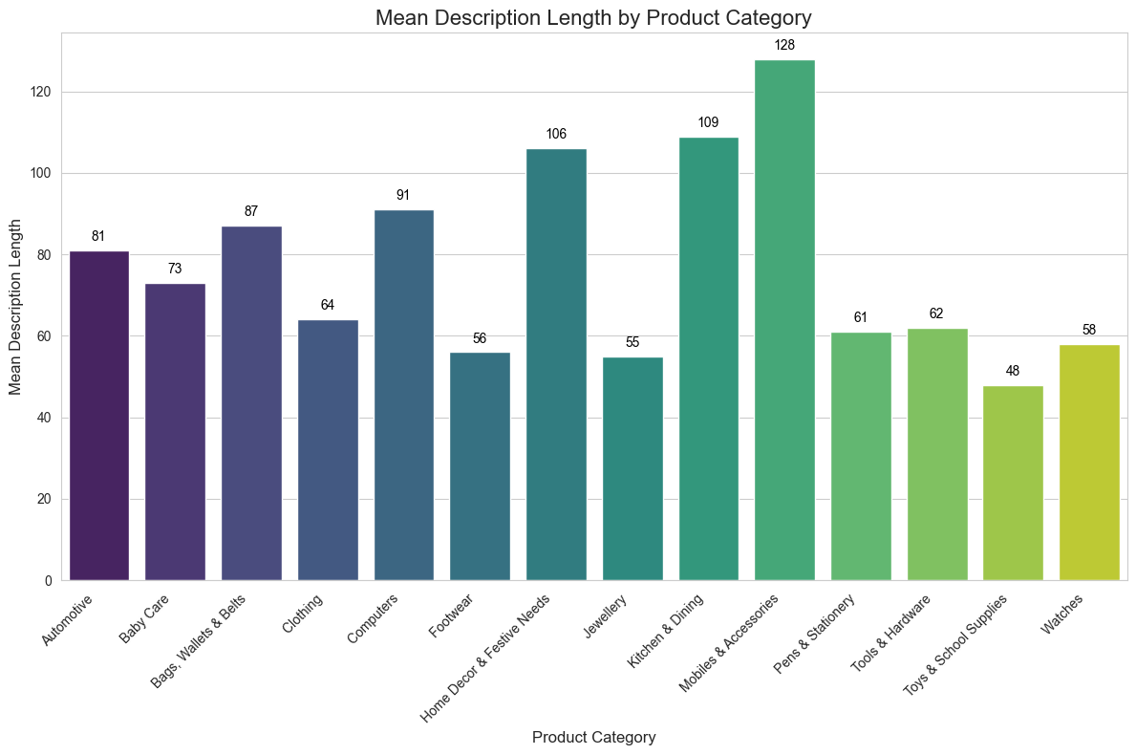
Description Length Distribution by Category
The average Description length is 70 before Text normalization
Mobiles& Accessories, Kitchen & Dining have the Highest Description length
While Toy & school Supplies , Jewellery have the lowest

Slide 4
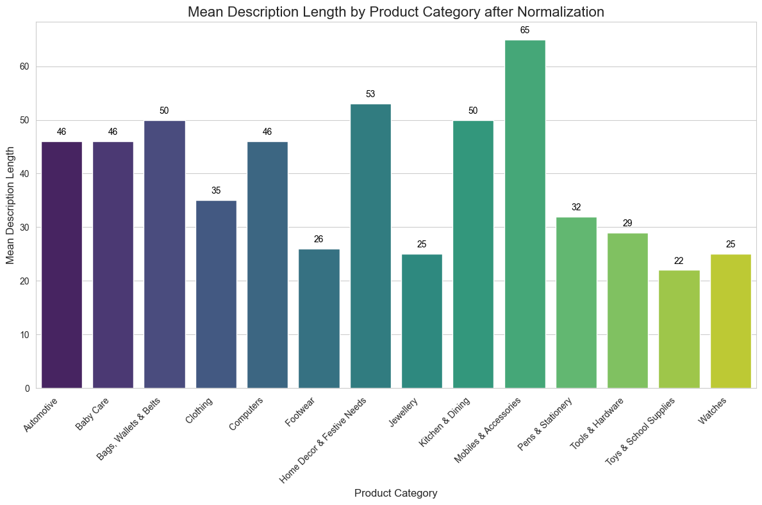
After Applying Text Normalization
Mean length Reduced from 70 words to 36
Reduction of approximately 49% is achieved

Slide 5
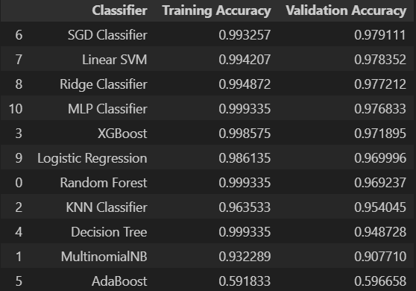
Baseline Model Accuracy Score
Best performing model is SGD Classifier

Slide 6
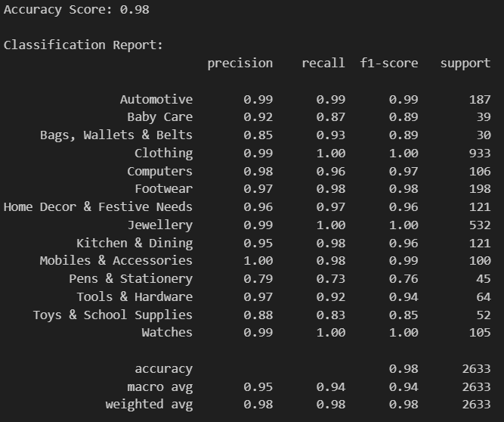
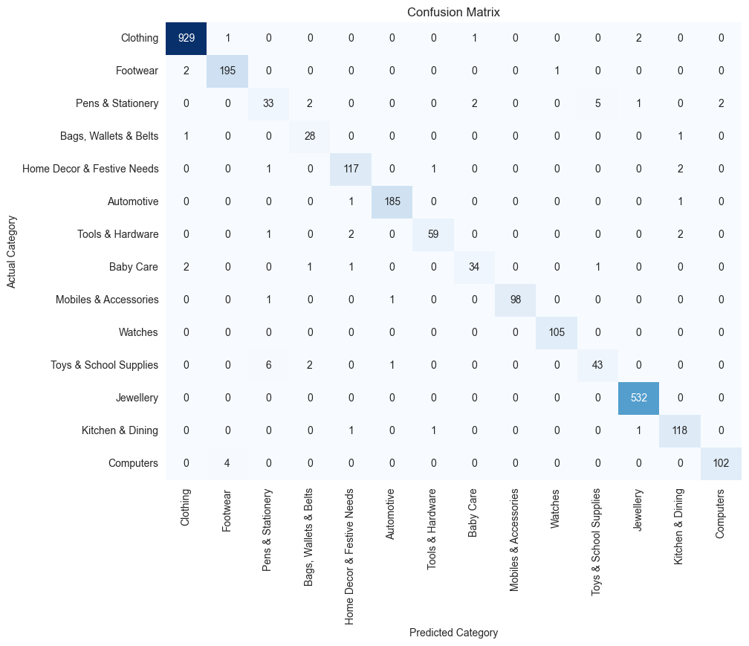
Best SGD Model Evaluation

Slide 7
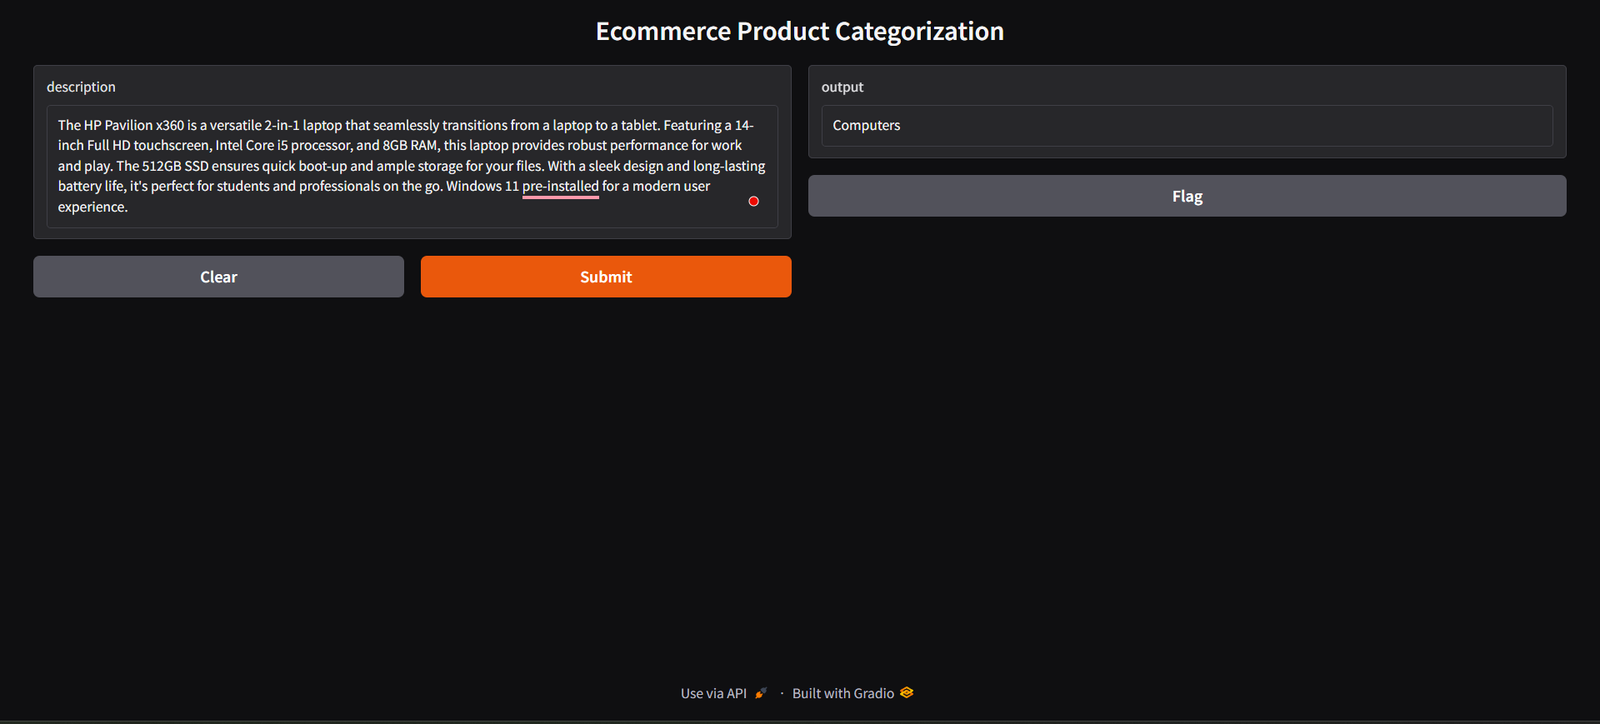
Deployment
Deployed model on web interface using Gradio

Slide 8
Conclusion
Model Accuracy:
Achieved an accuracy score of 0.98 in predicting product categories with train dataset.
Achieved accuracy score of 0.86 with test dataset
Classification Report Summary:
Strong performance observed in key categories:
Automotive
Clothing
Jewellery
Precision and recall metrics are exceptionally high in these categories.
Model effectively identifies products while minimizing false positives and false negatives.
Future Work:
Fine-tune the model further.
Explore additional features to improve predictive performance.

Slide 9
Thank you

